Slide 1
Cloud Security
By
Arun

Slide 2
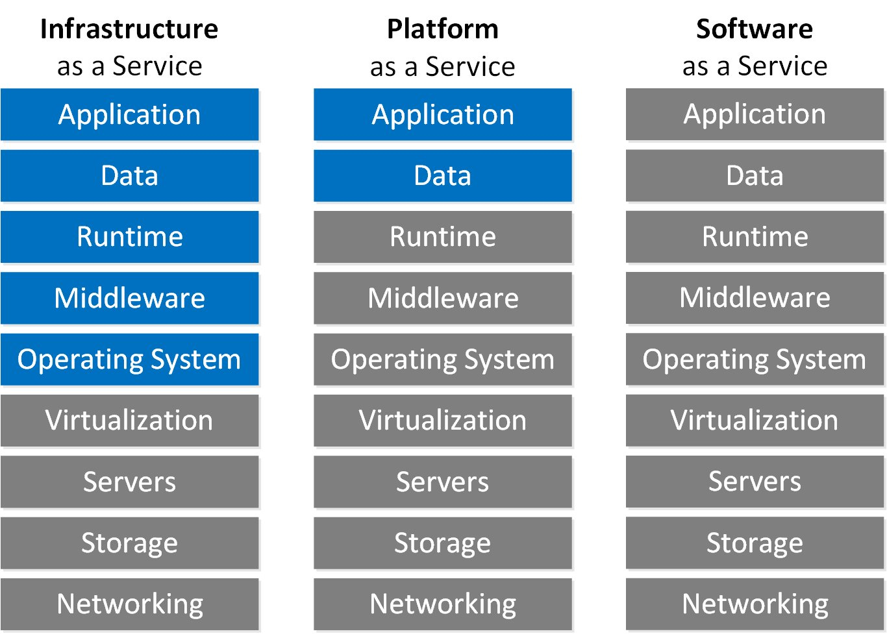

Slide 3
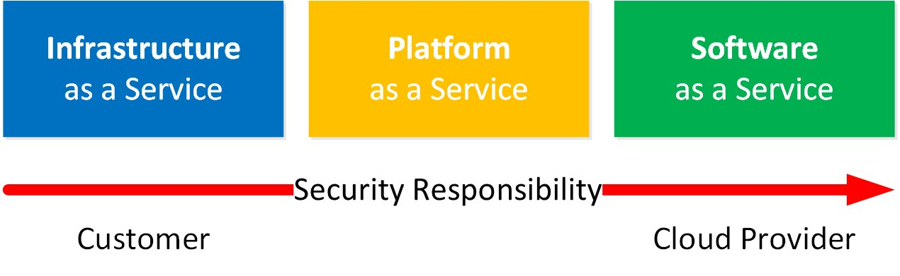

Slide 4
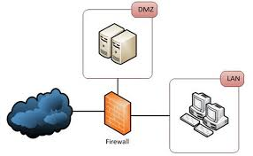

Slide 5
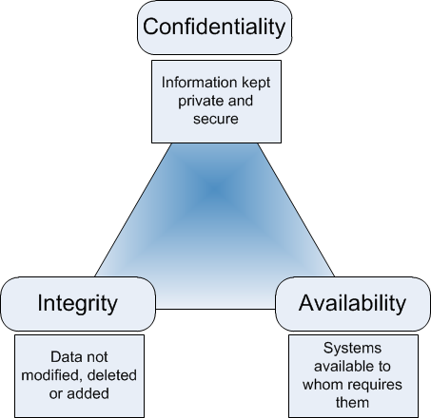

Slide 6
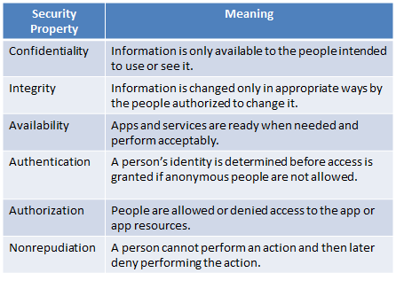

Slide 7
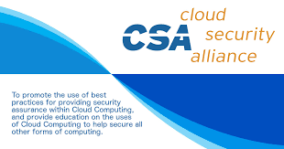

Slide 8
Recommendation by CSA
Cloud providers(GCP, AWS) should clearly document their internal security controls and customer security features so the cloud user can make an informed decision. Providers should also properly
design and implement those controls
Cloud users should, for any given cloud project, build a Responsibilities matrix to document who is implementing which controls and how.

Slide 9
2 Tools Mostly used
Consensus Assessments Initiative Questionnaire (CAIQ): a template for cloud providers to document their security and compliance controls
Cloud Controls Matrix (CCM): lists cloud security controls and maps them to multiple security and compliance standards. You can also use the CCM to document security responsibilities.

Slide 10
Regulatory Compliance Laws
Payment Card Industry Data Security Standard (PCI DSS): an information security standard for organizations that handle credit cards
Health Insurance Portability and Accountability Act (HIPAA): US legislation that provides data security and privacy to protect medical information
General Data Protection Regulation (GDPR): EU legislation on data privacy and protection for individuals within the European Union

Slide 11
ISO Standards
ISO 27017: ISO standard that provides guidelines on the security aspects of cloud computing
ISO 27018: ISO standard that provides guidelines on protecting Personally Identifiable Information (PII) in cloud computing

Slide 12
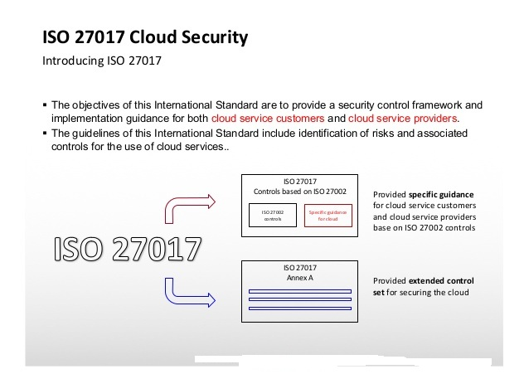

Slide 13
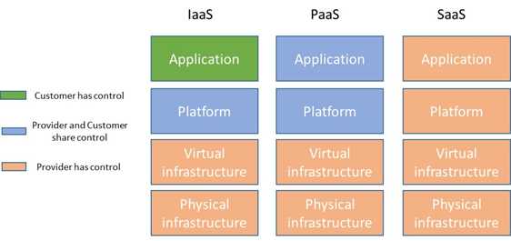

Slide 14
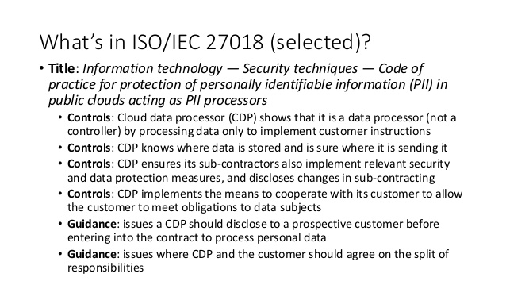

Slide 15
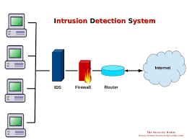

Slide 16
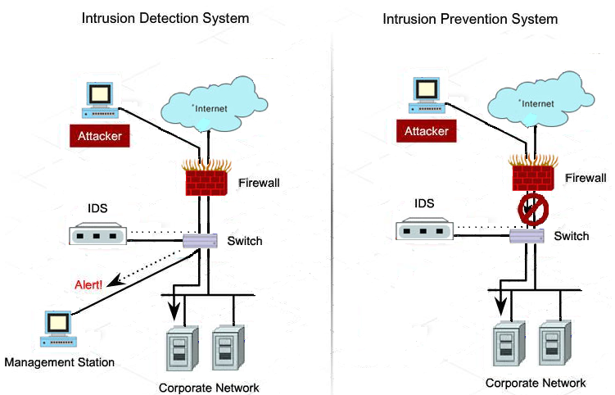

Slide 17
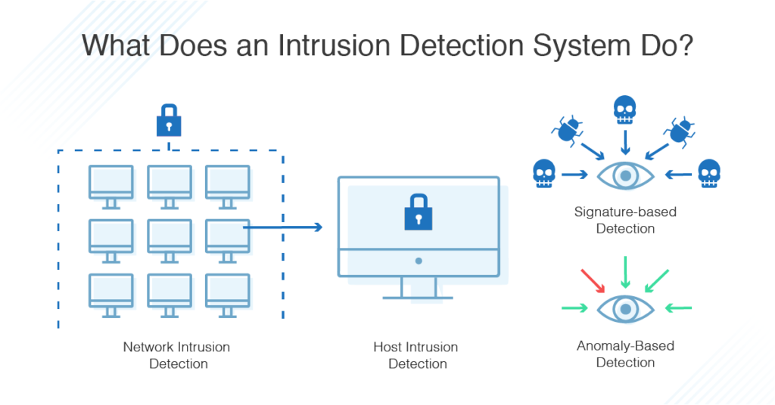

Slide 18
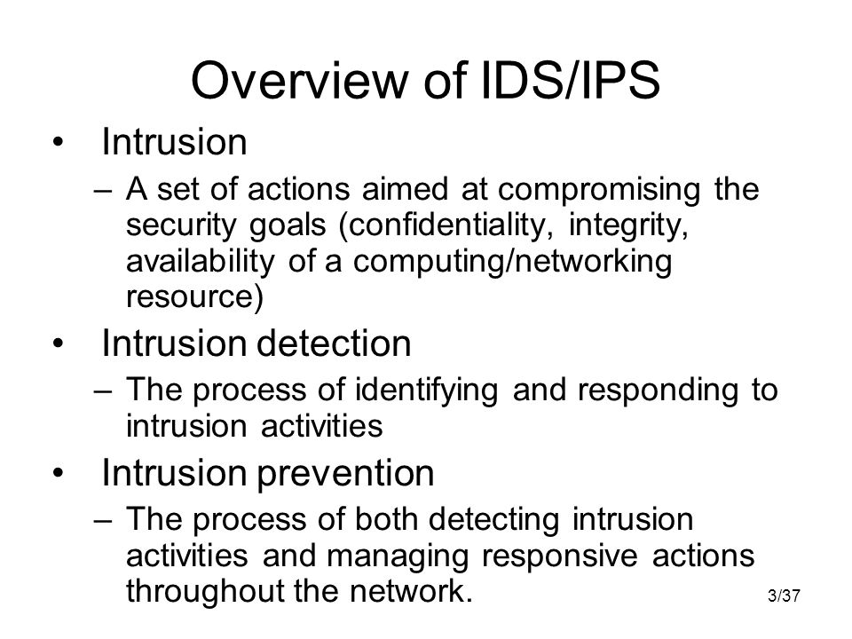

Slide 19
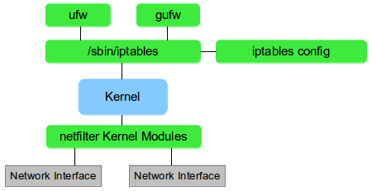

Slide 20
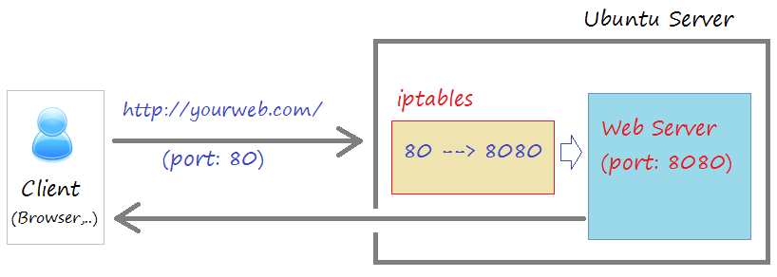

Slide 21
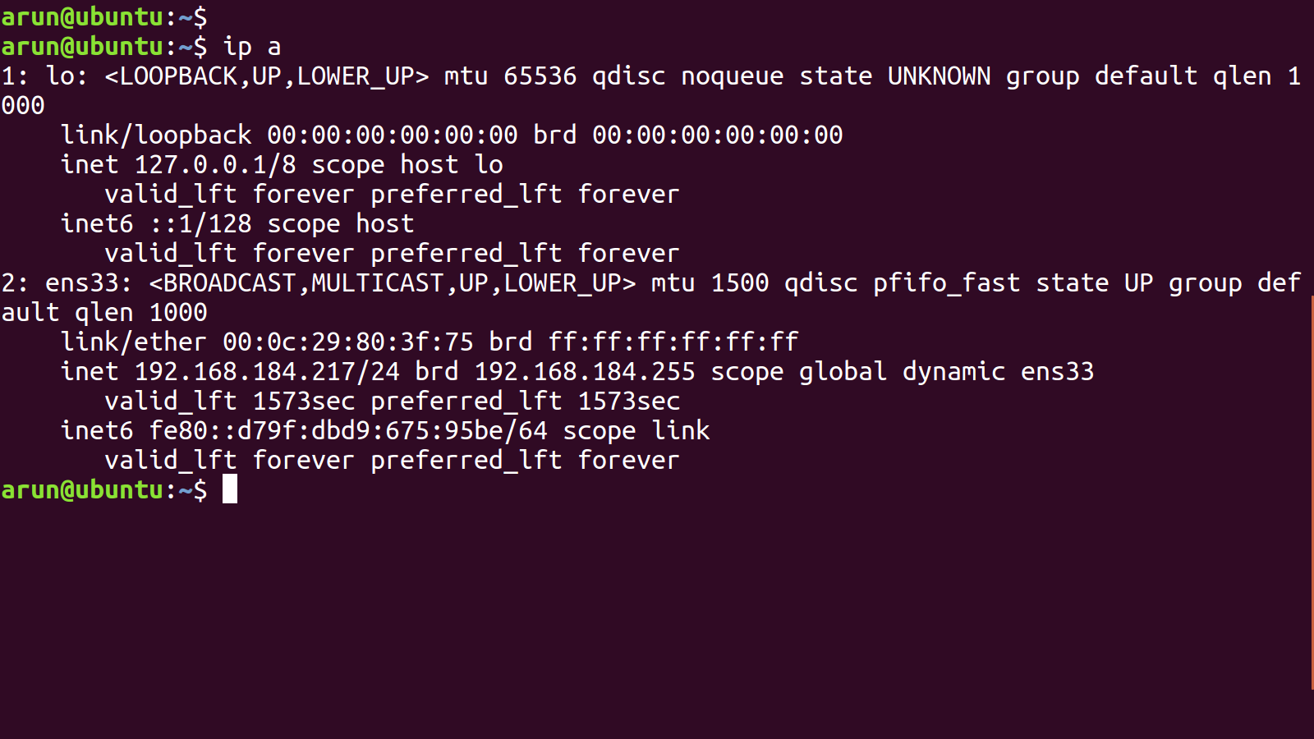

Slide 22
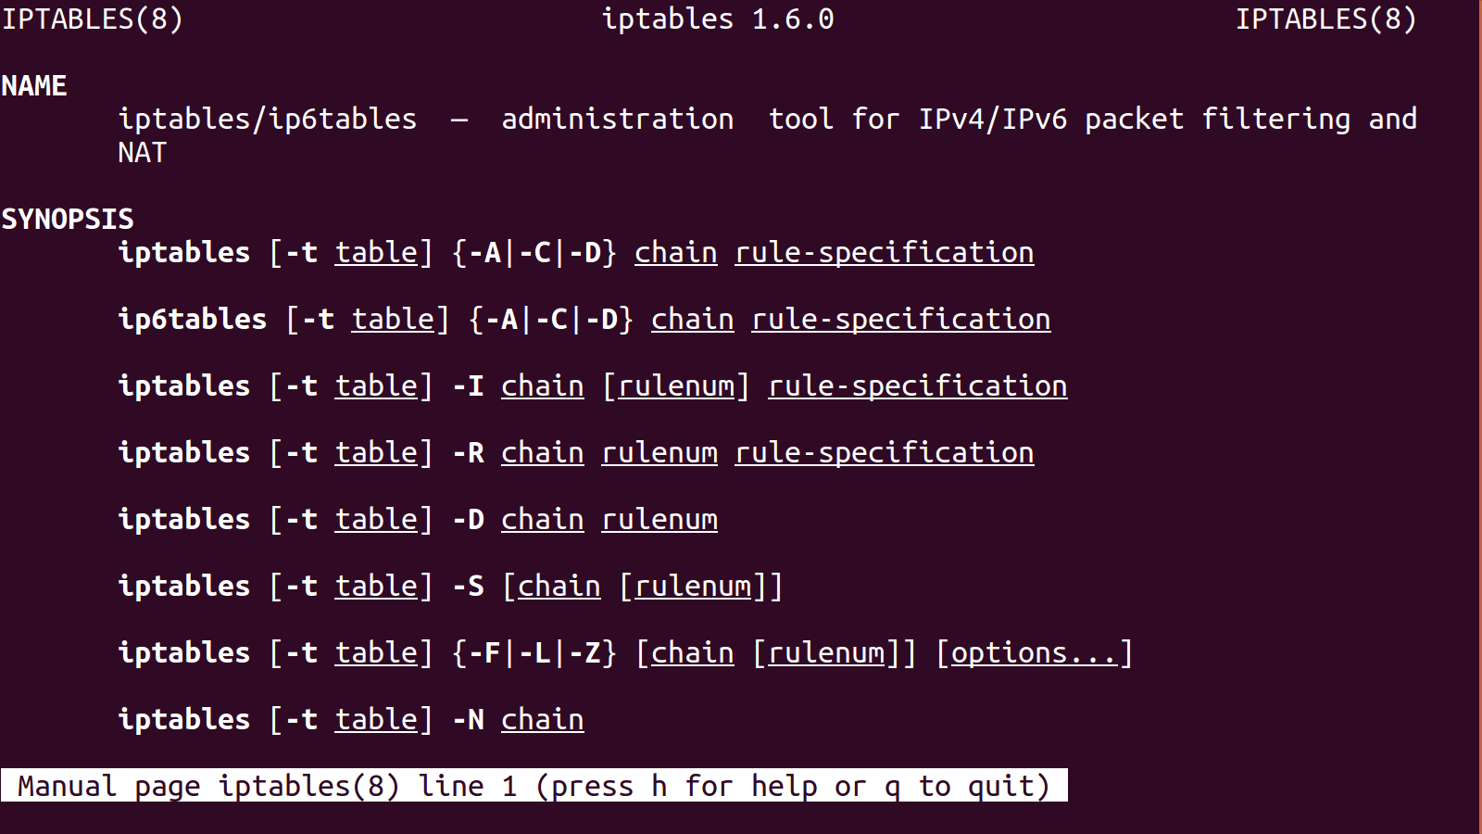

Slide 23
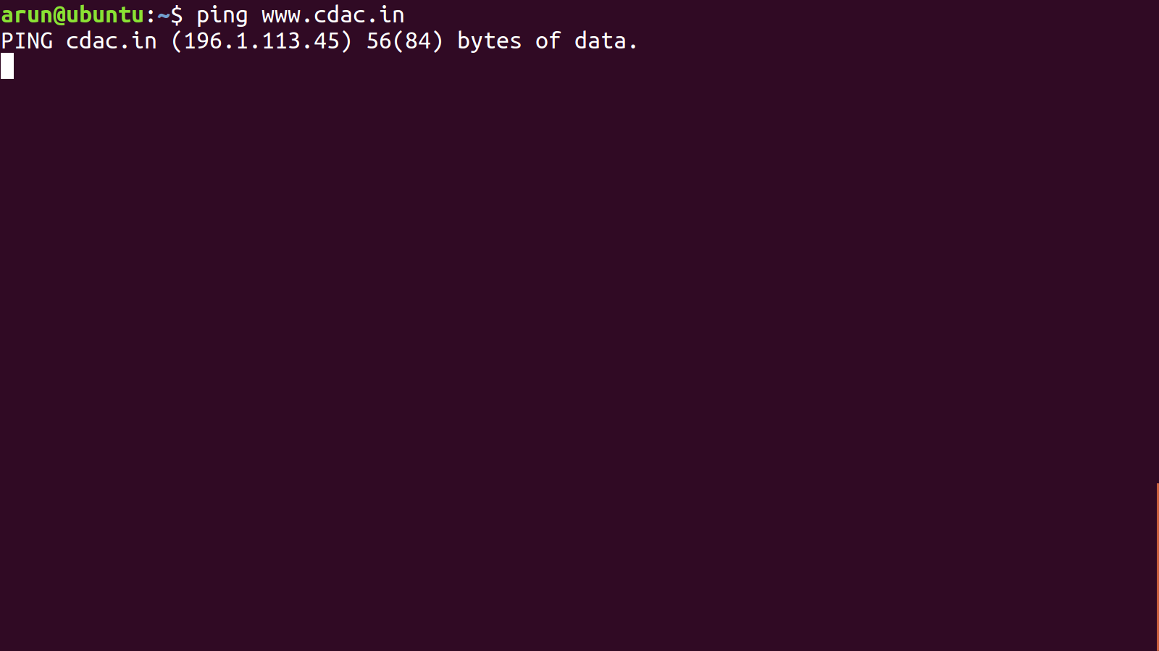

Slide 24
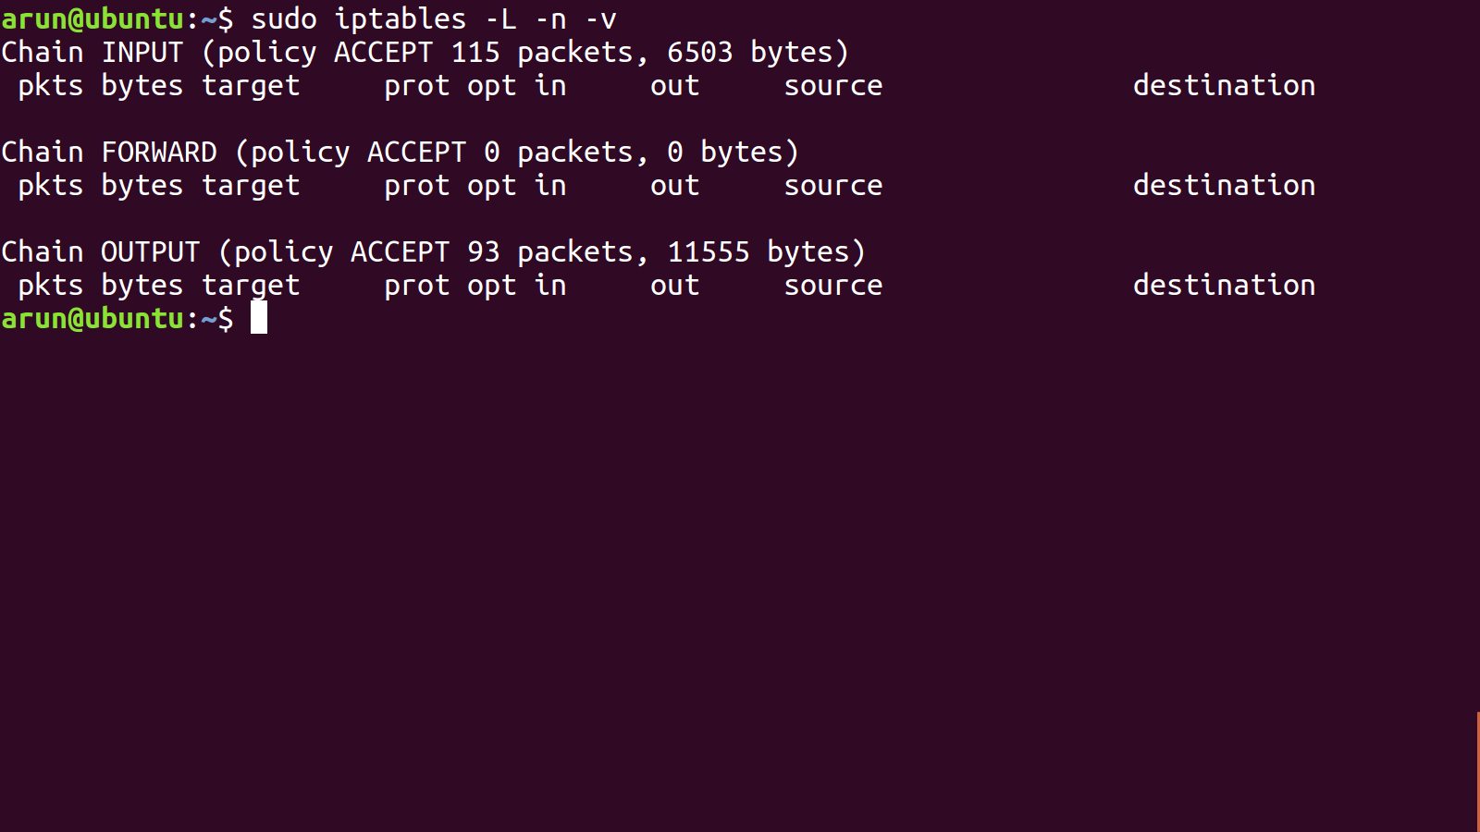

Slide 25
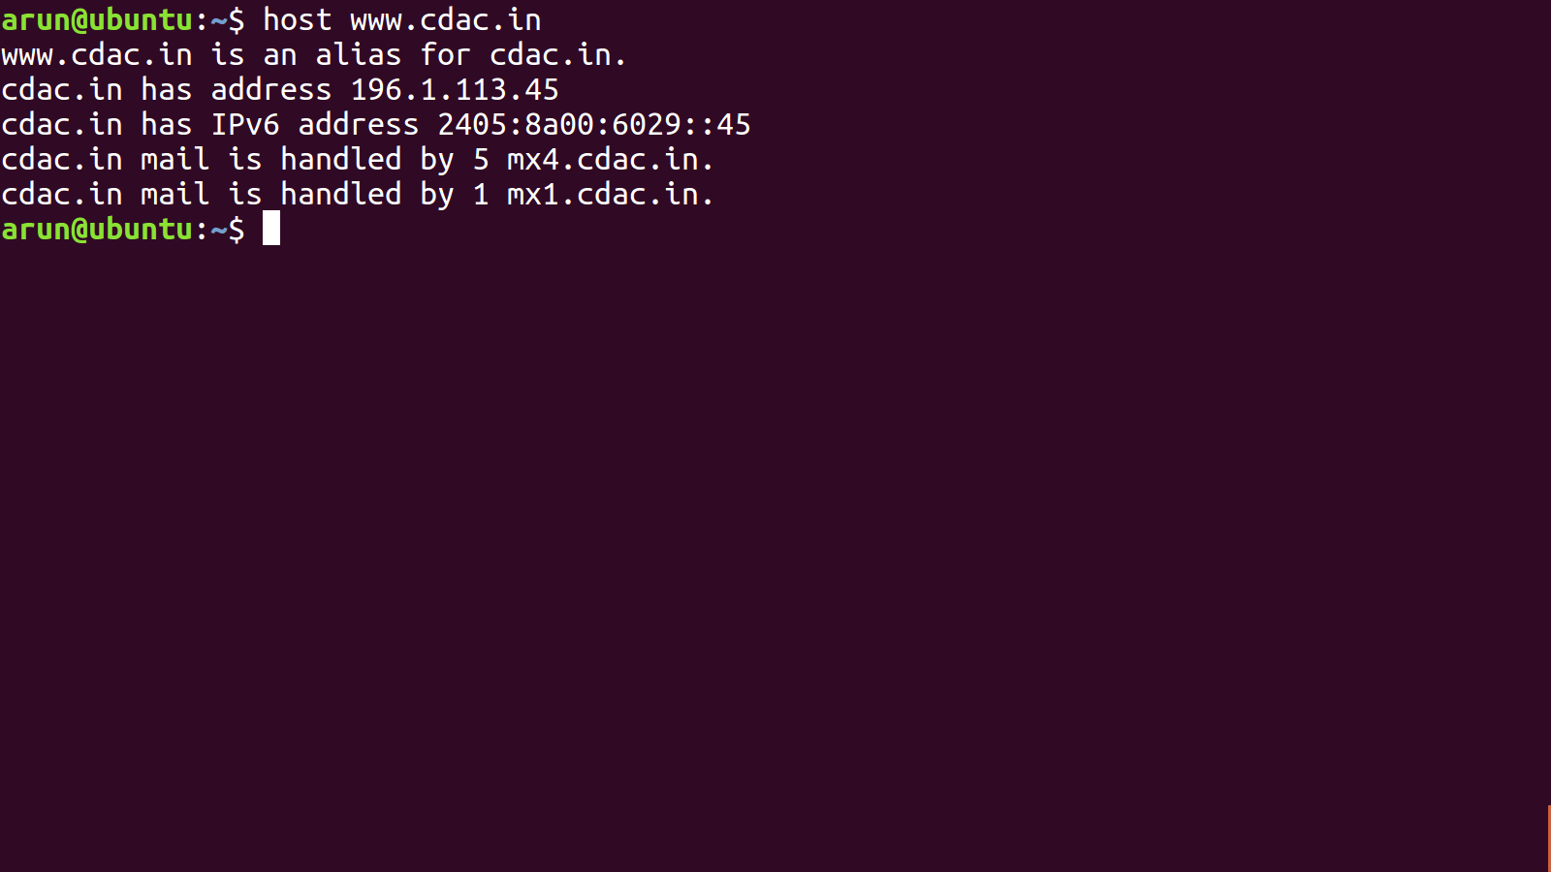

Slide 26
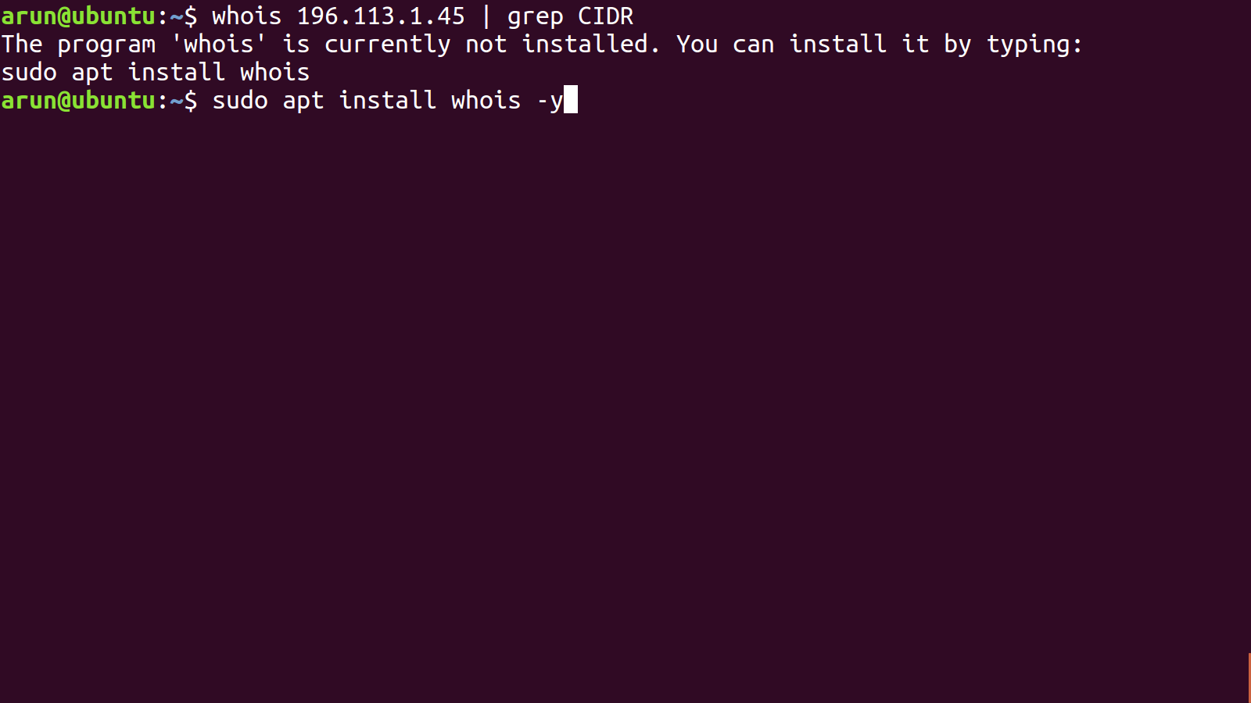

Slide 27
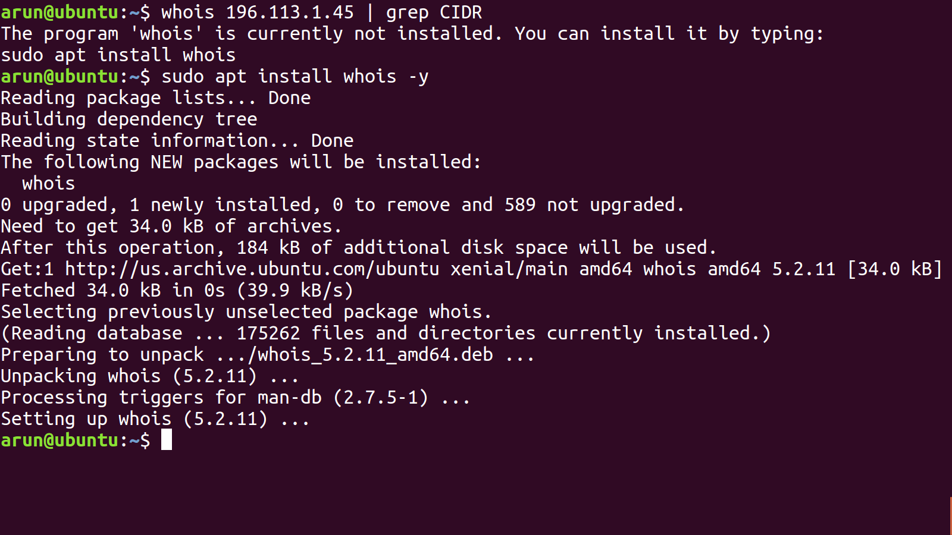

Slide 28
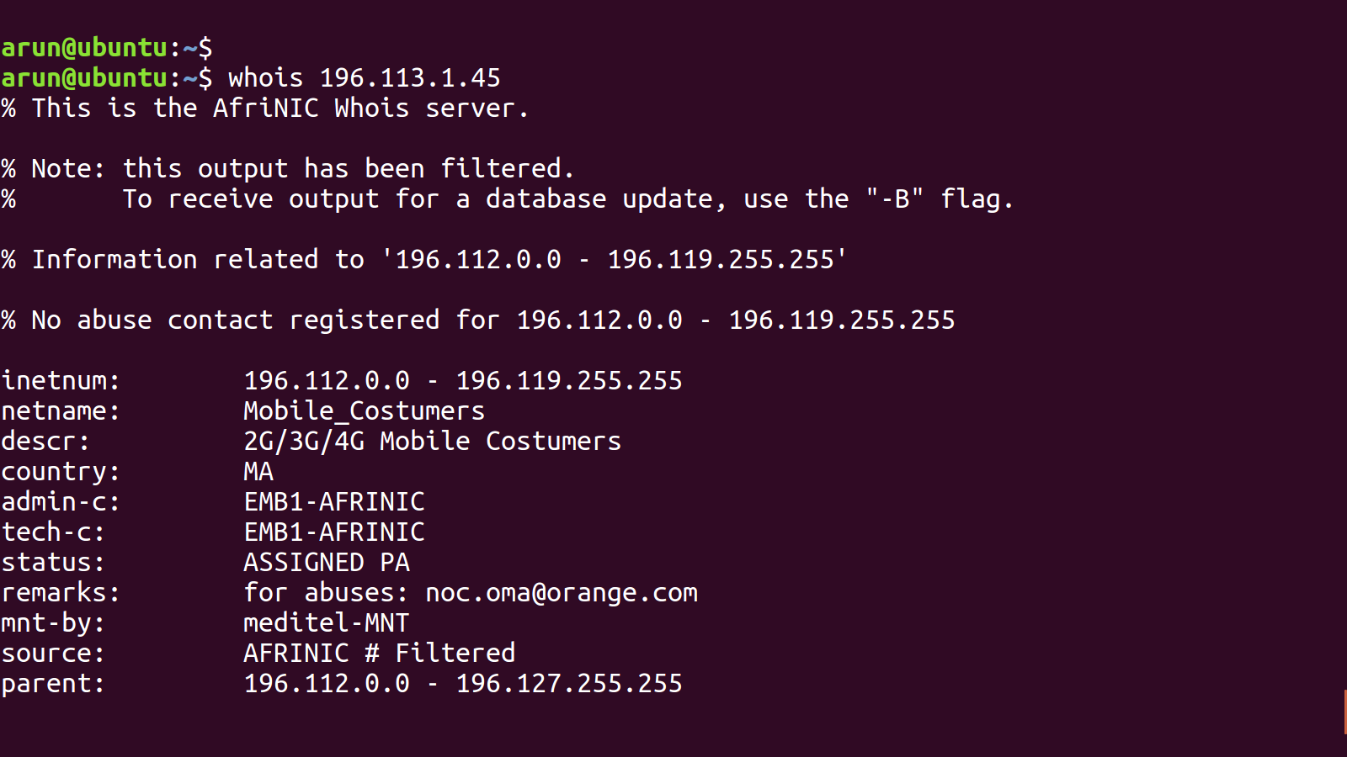

Slide 29
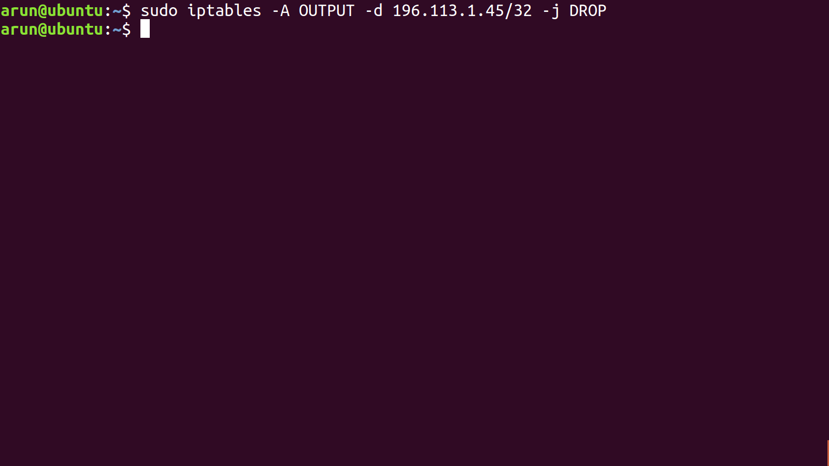

Slide 30
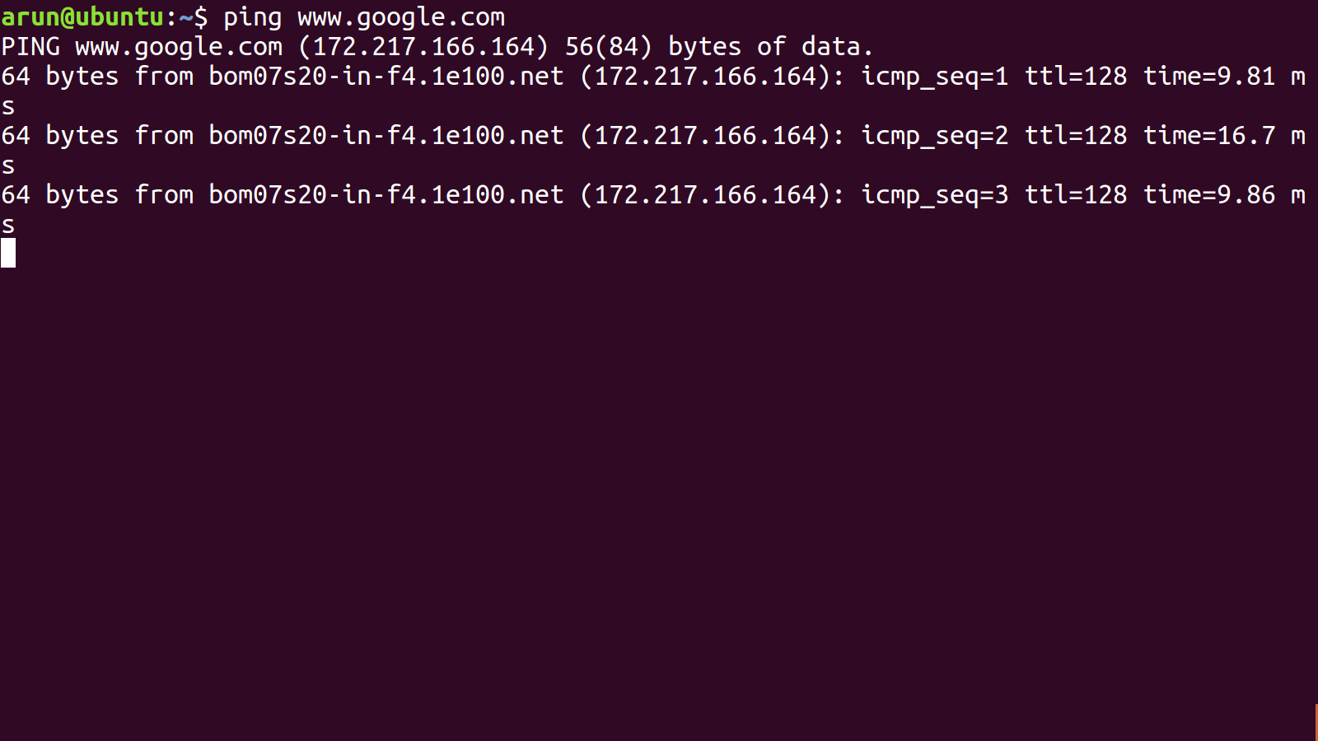

Slide 31
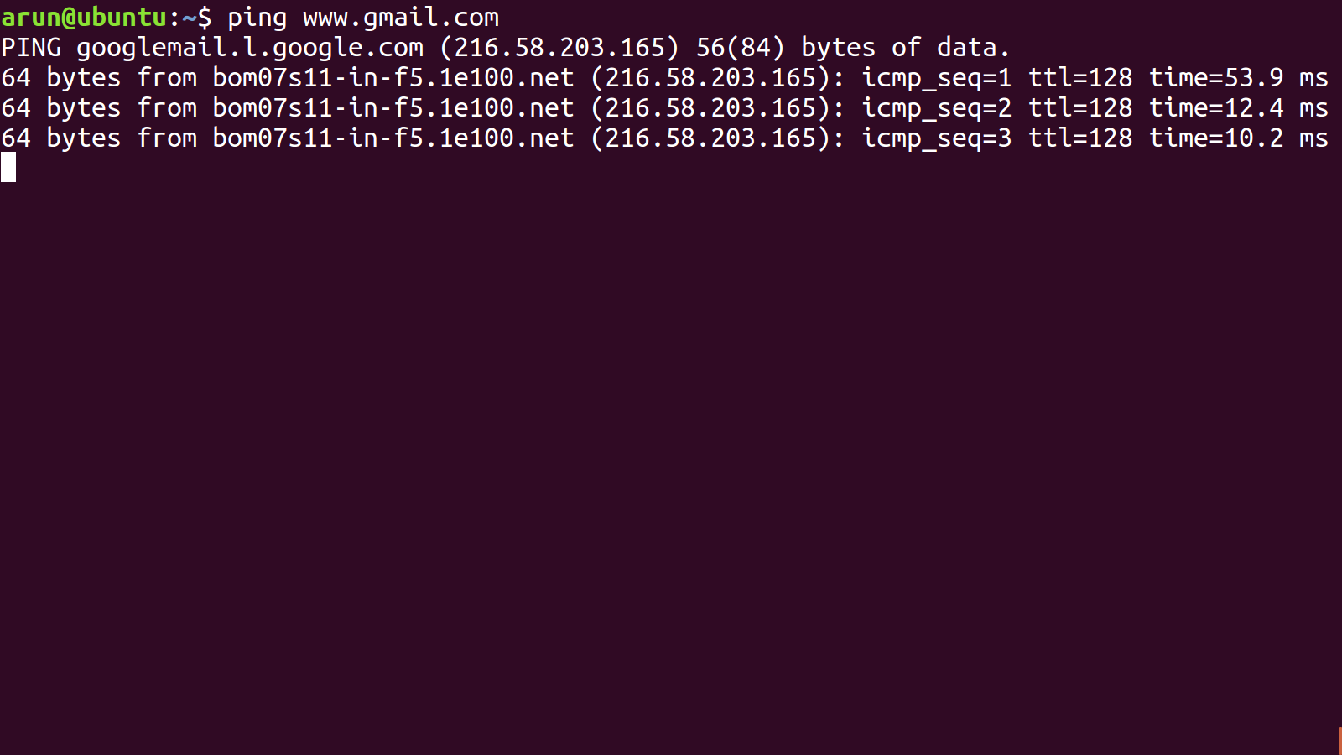

Slide 32
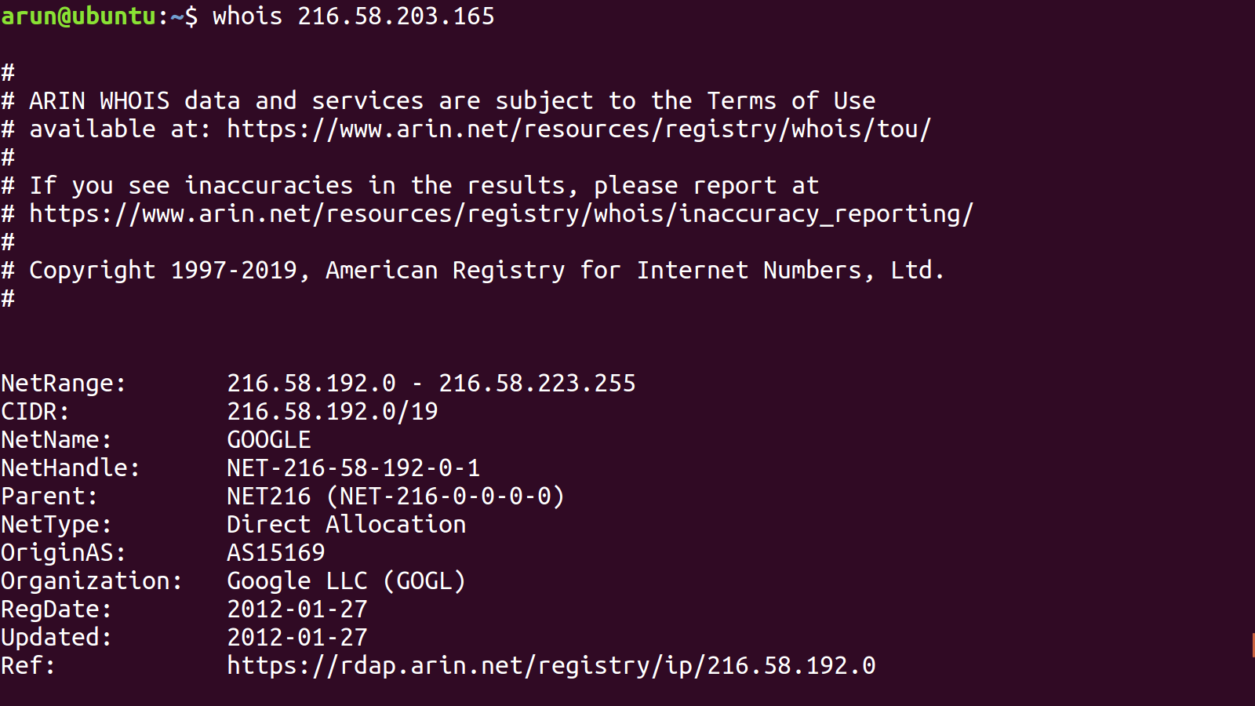

Slide 33
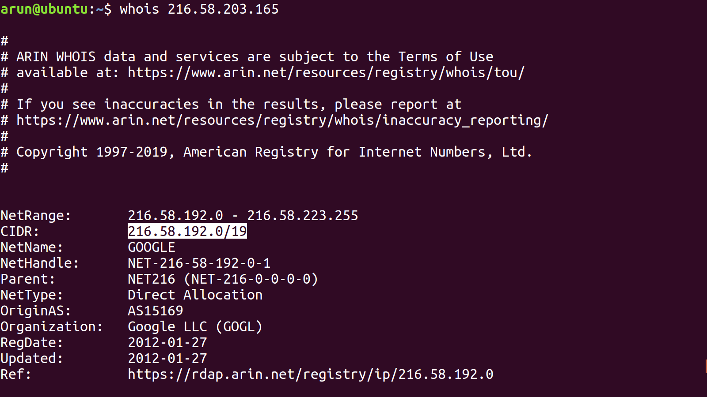

Slide 34
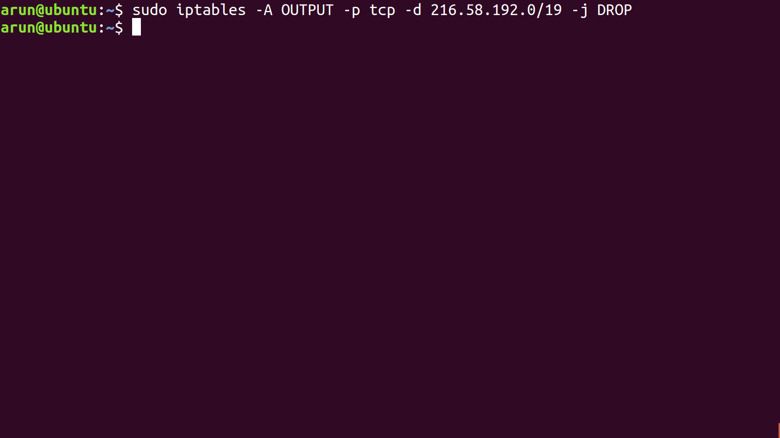

Slide 35
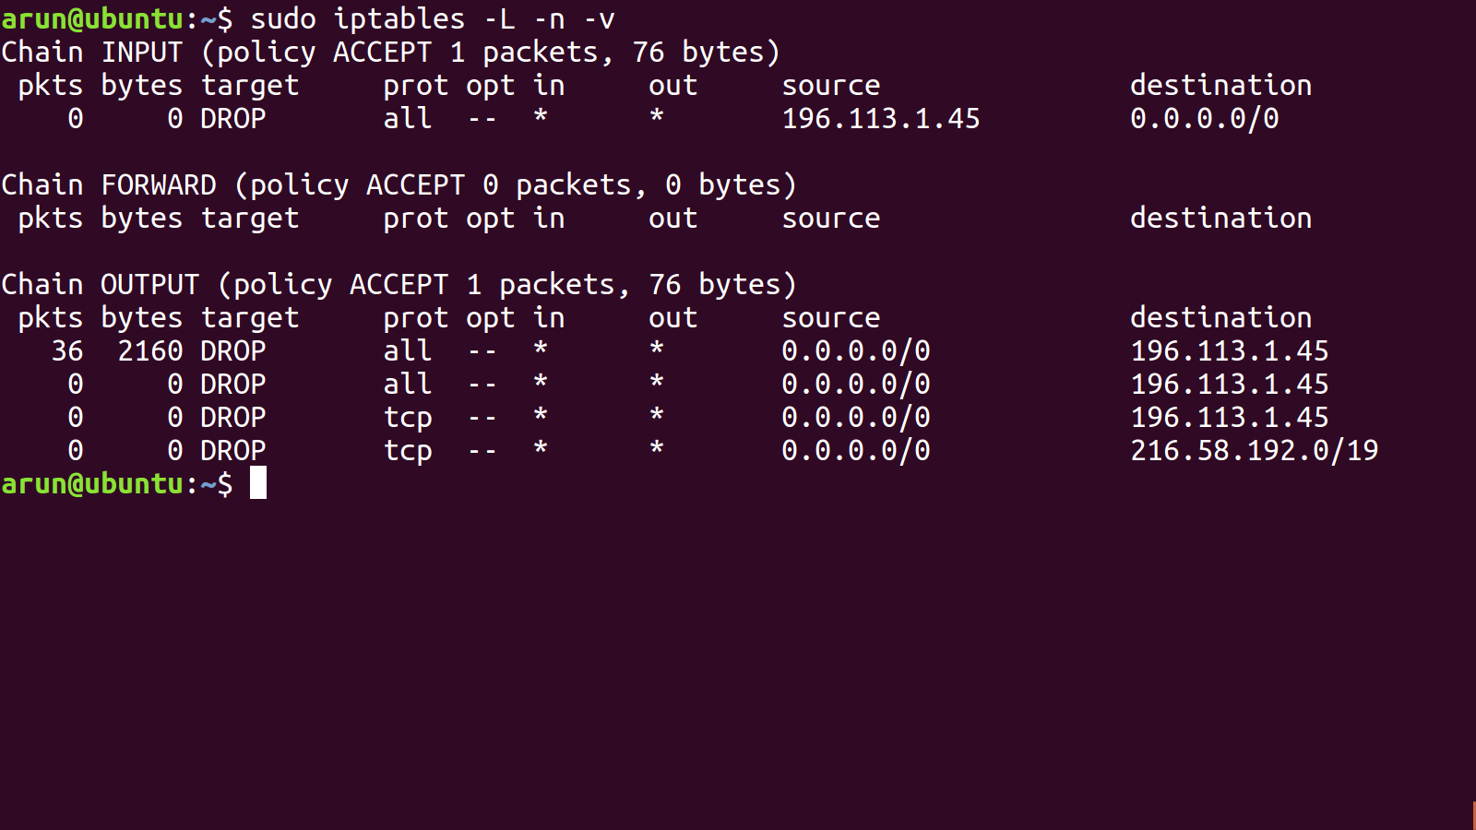

Slide 36
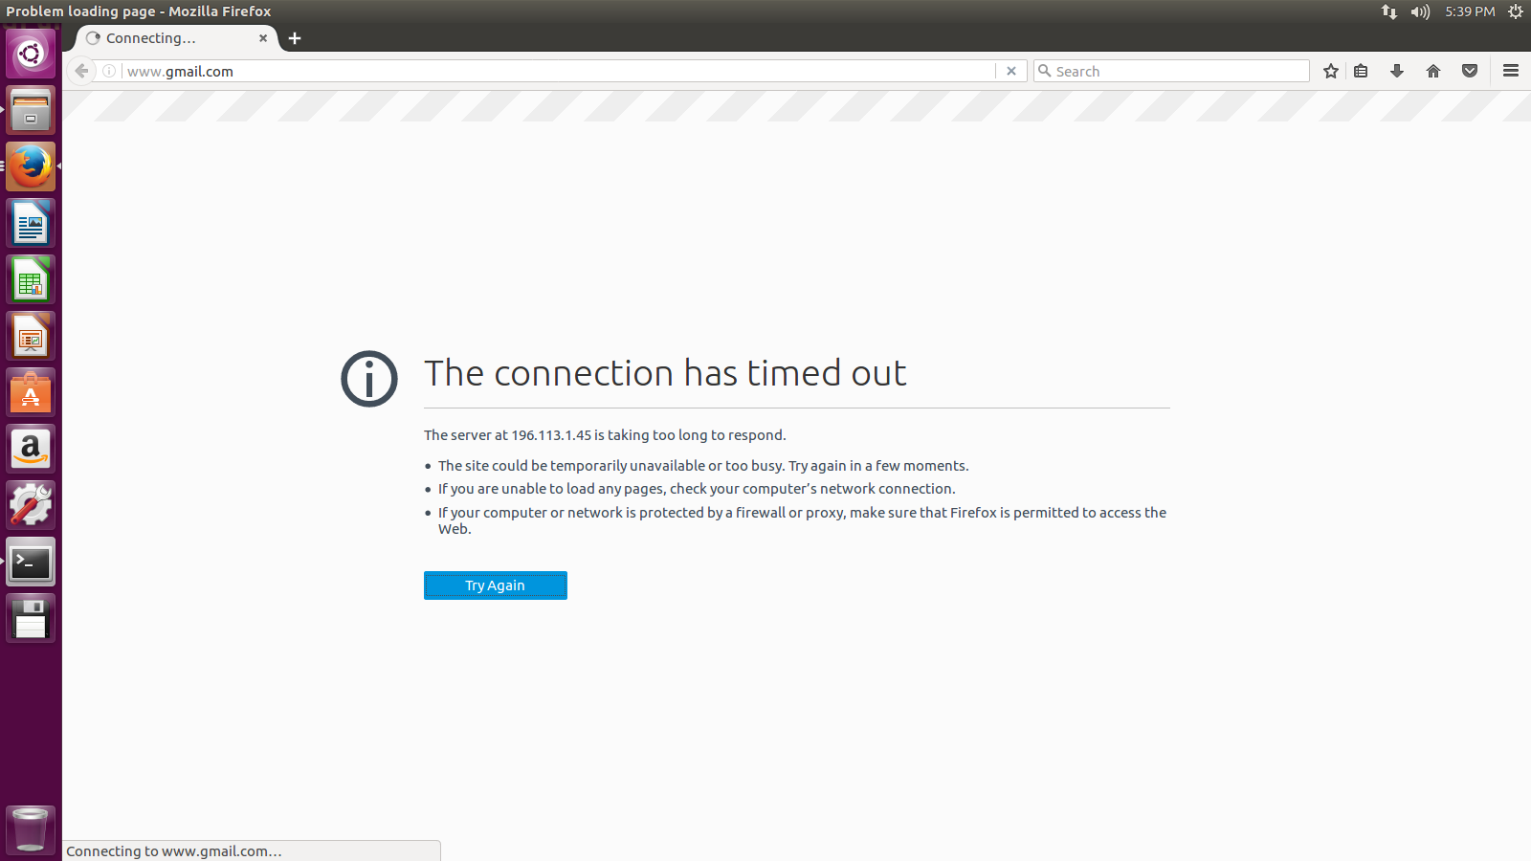

Slide 37
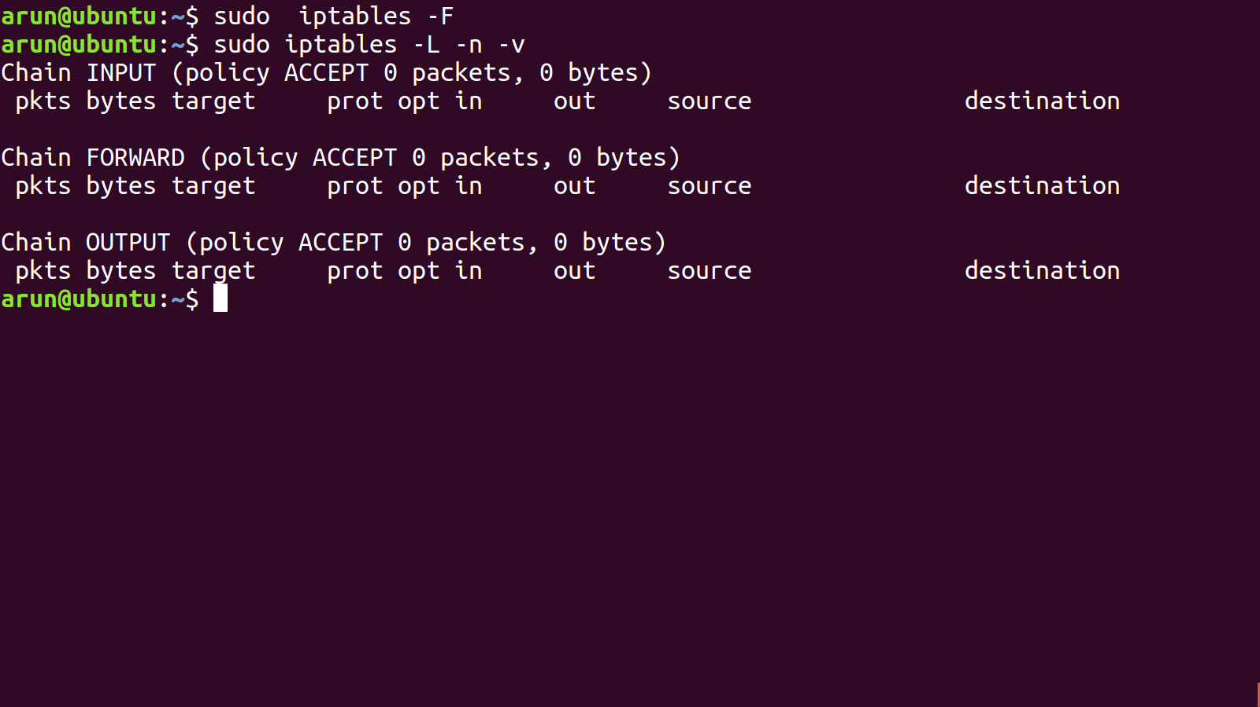

Slide 38
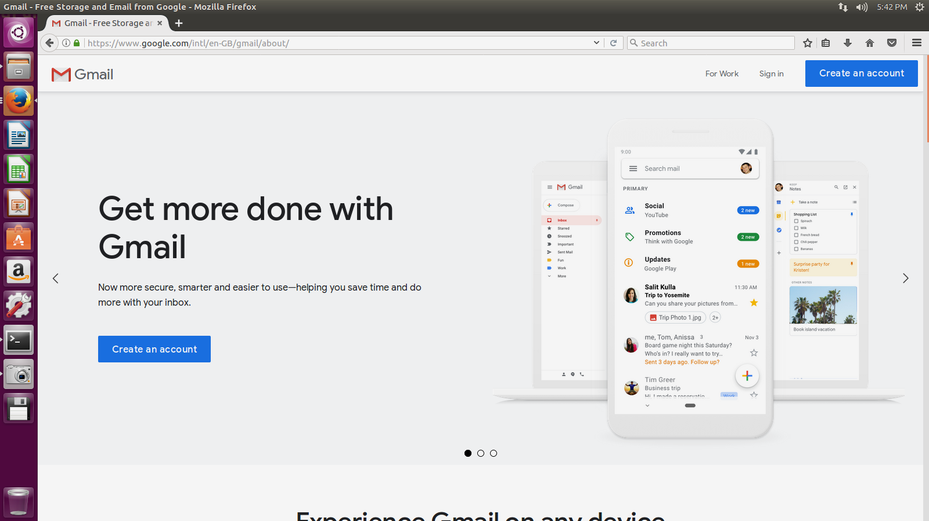

Slide 39
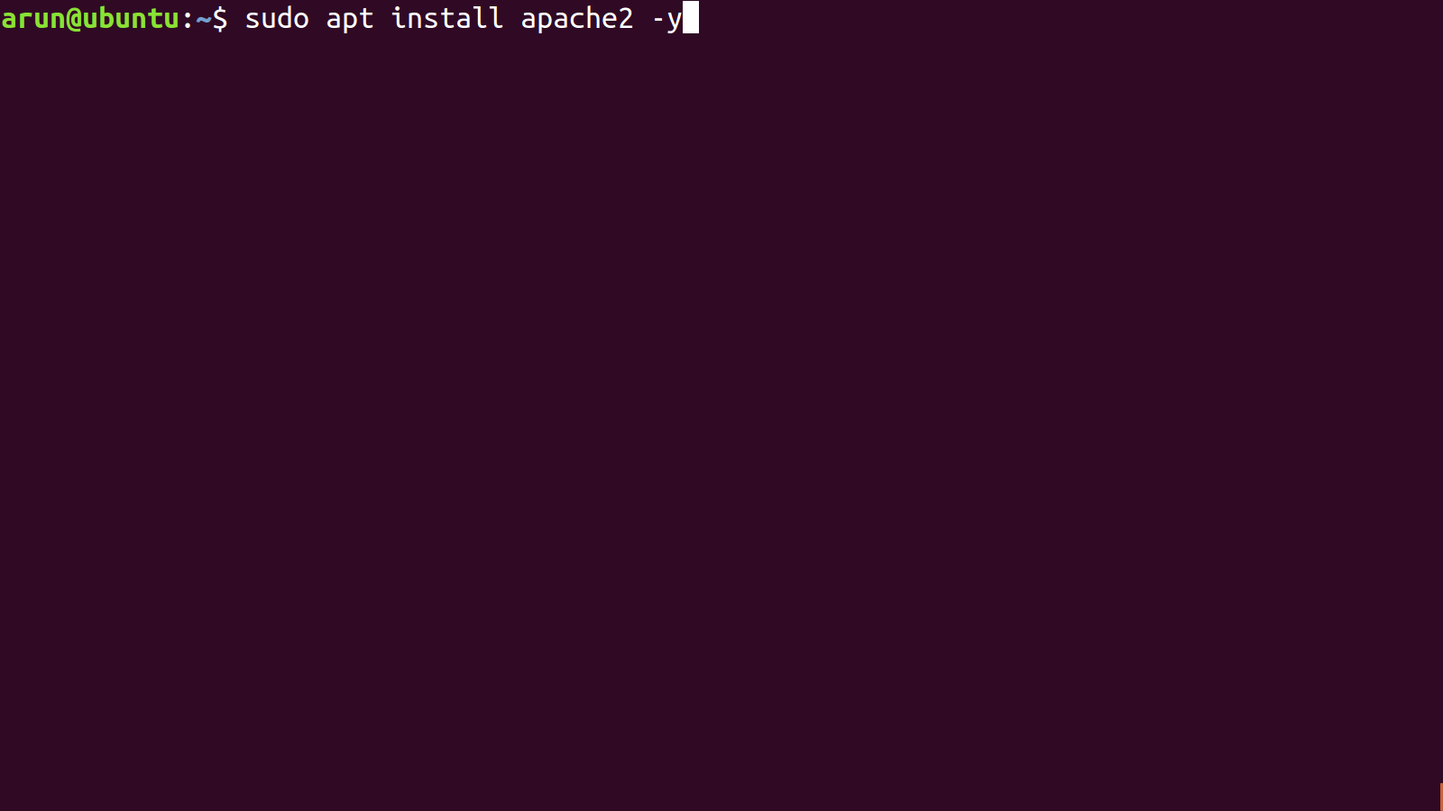

Slide 40
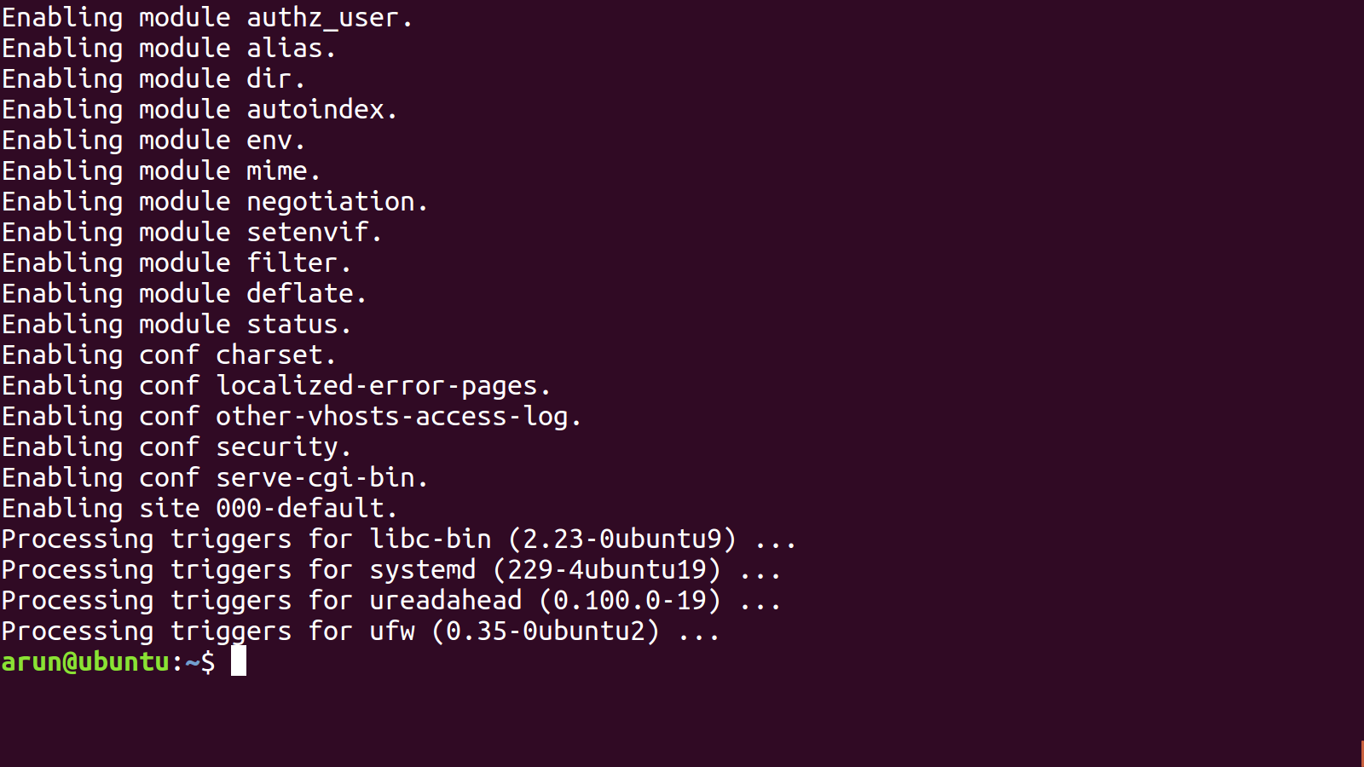

Slide 41
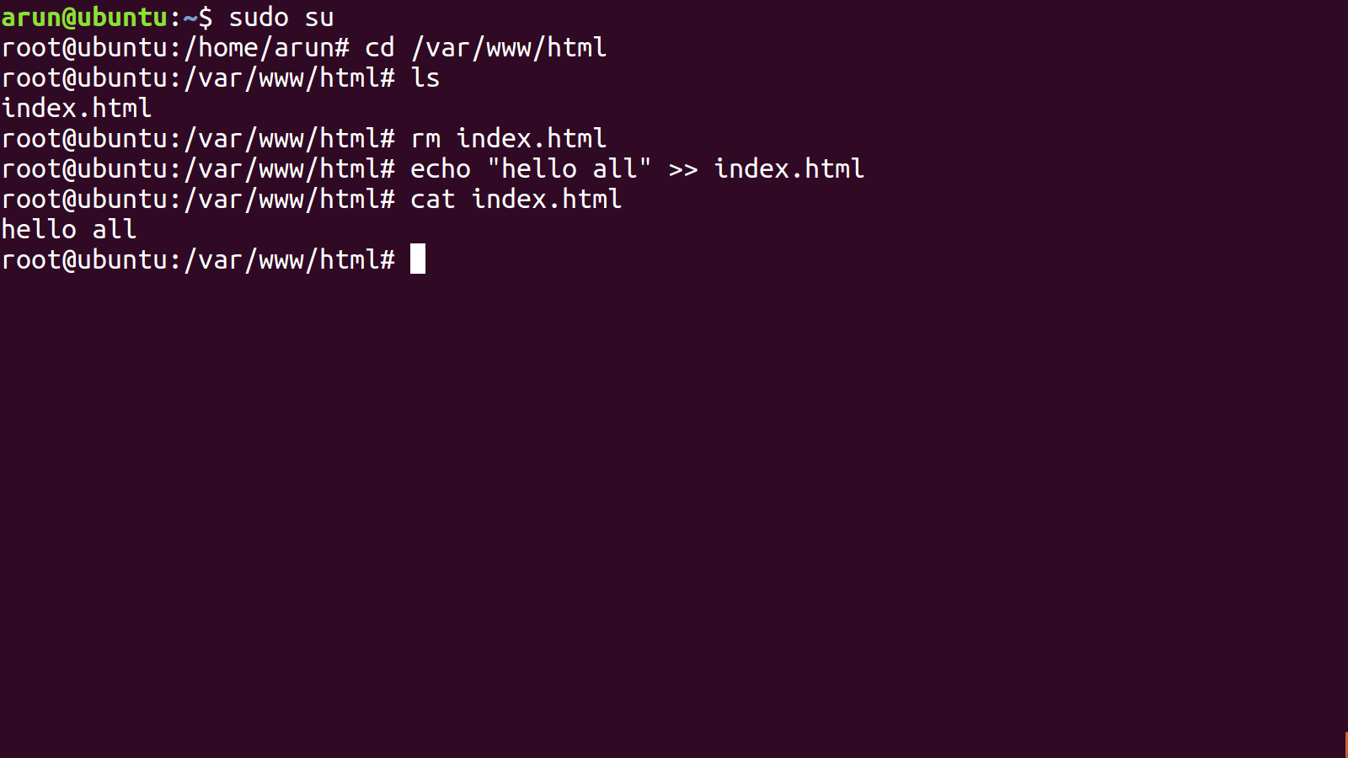

Slide 42
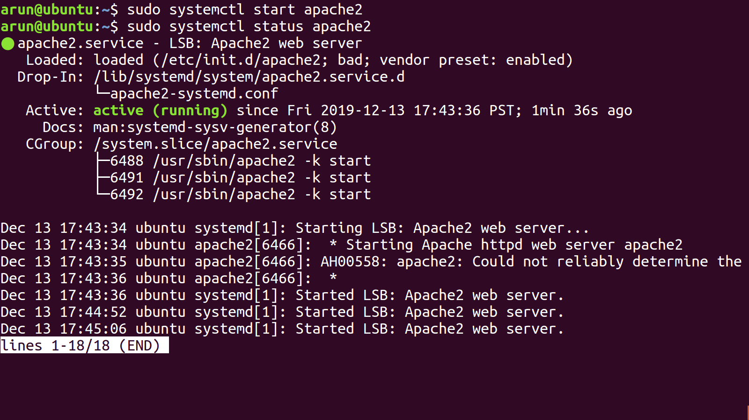

Slide 43
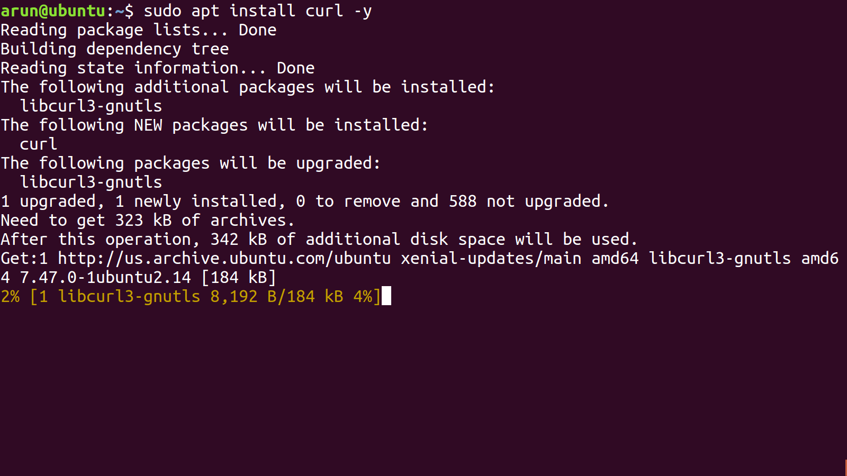

Slide 44
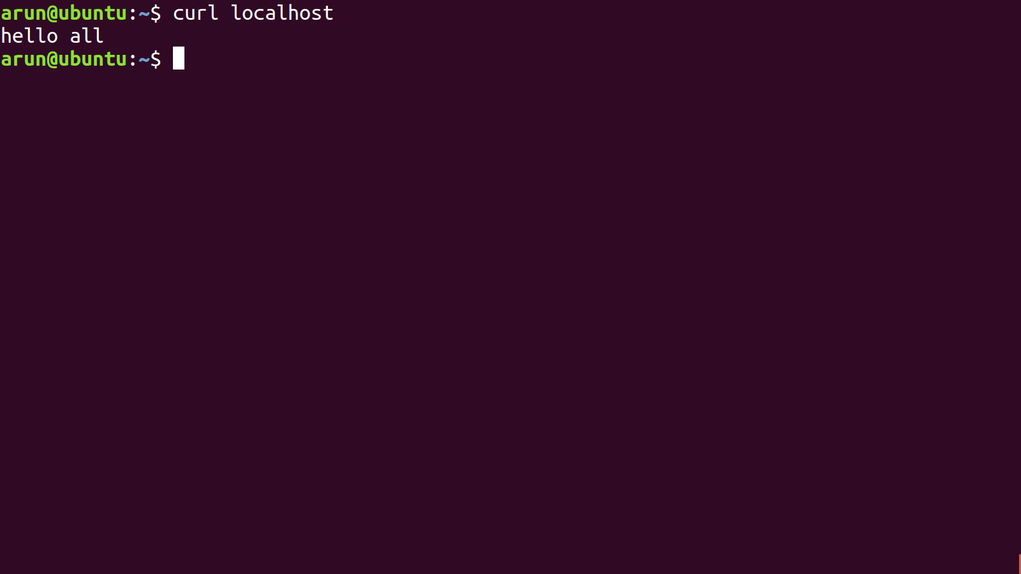

Slide 45
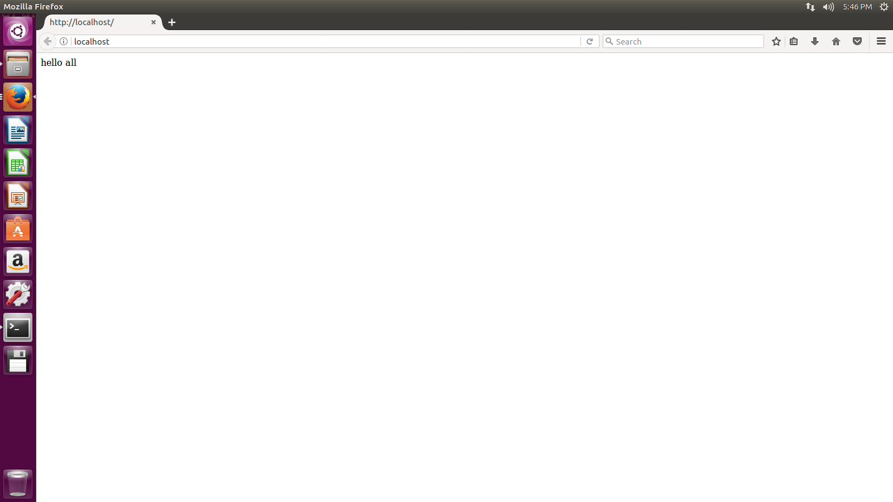

Slide 46
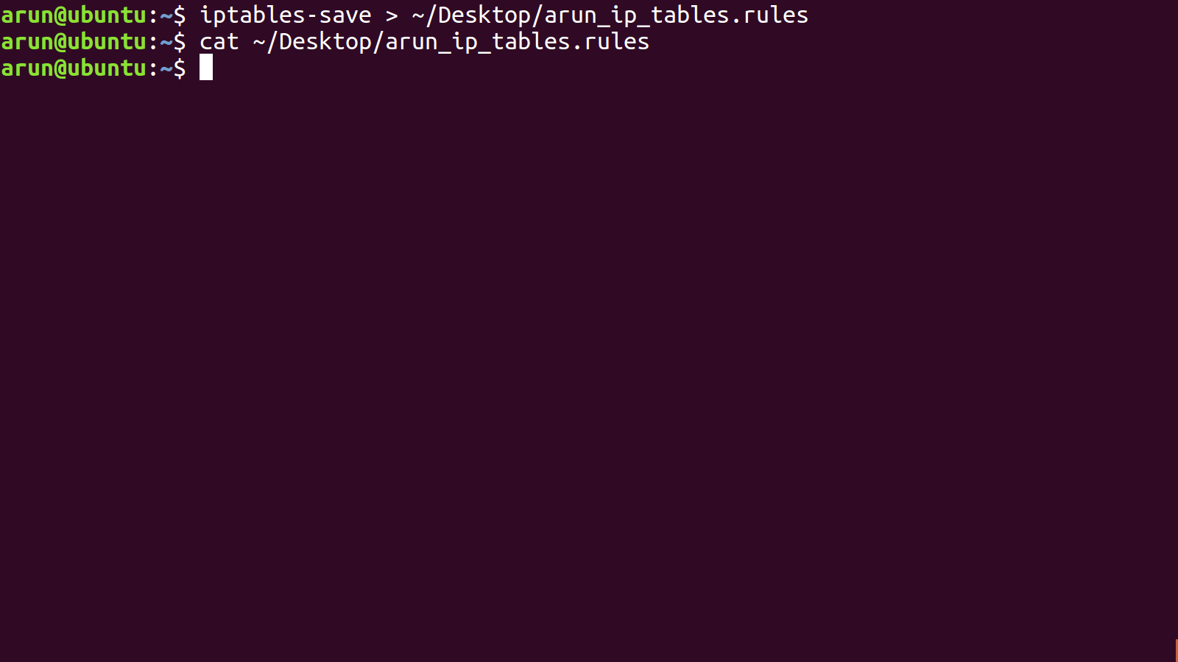

Slide 47
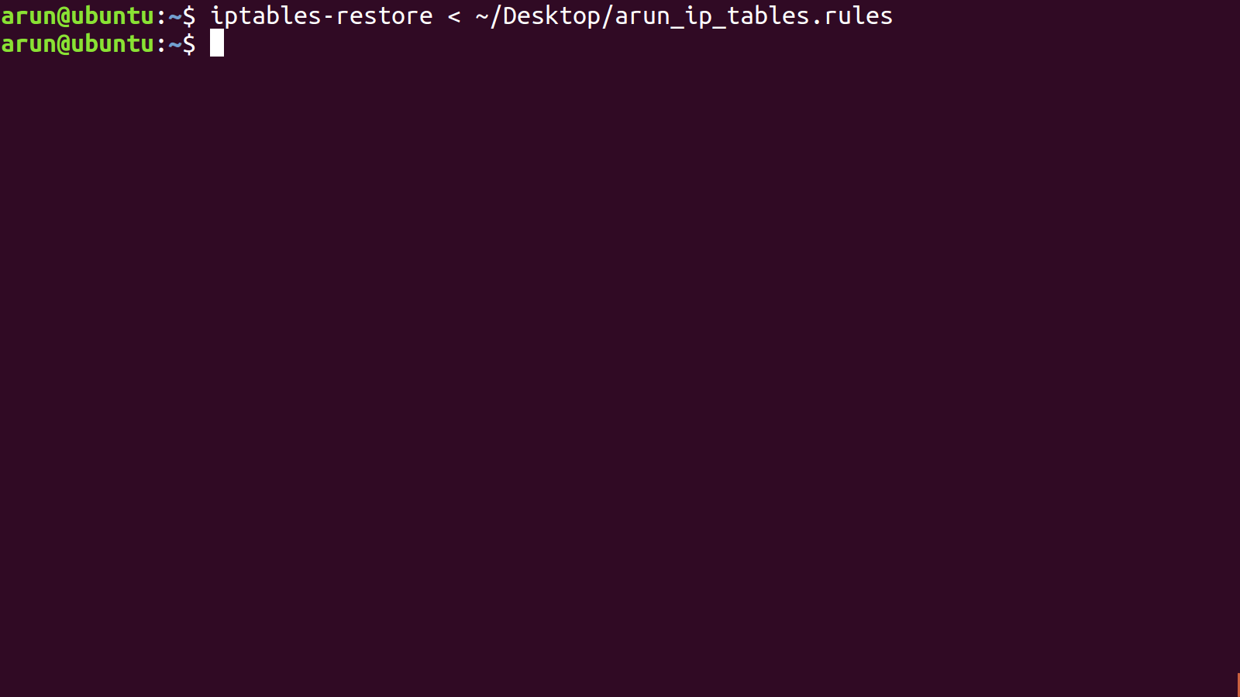

Slide 48
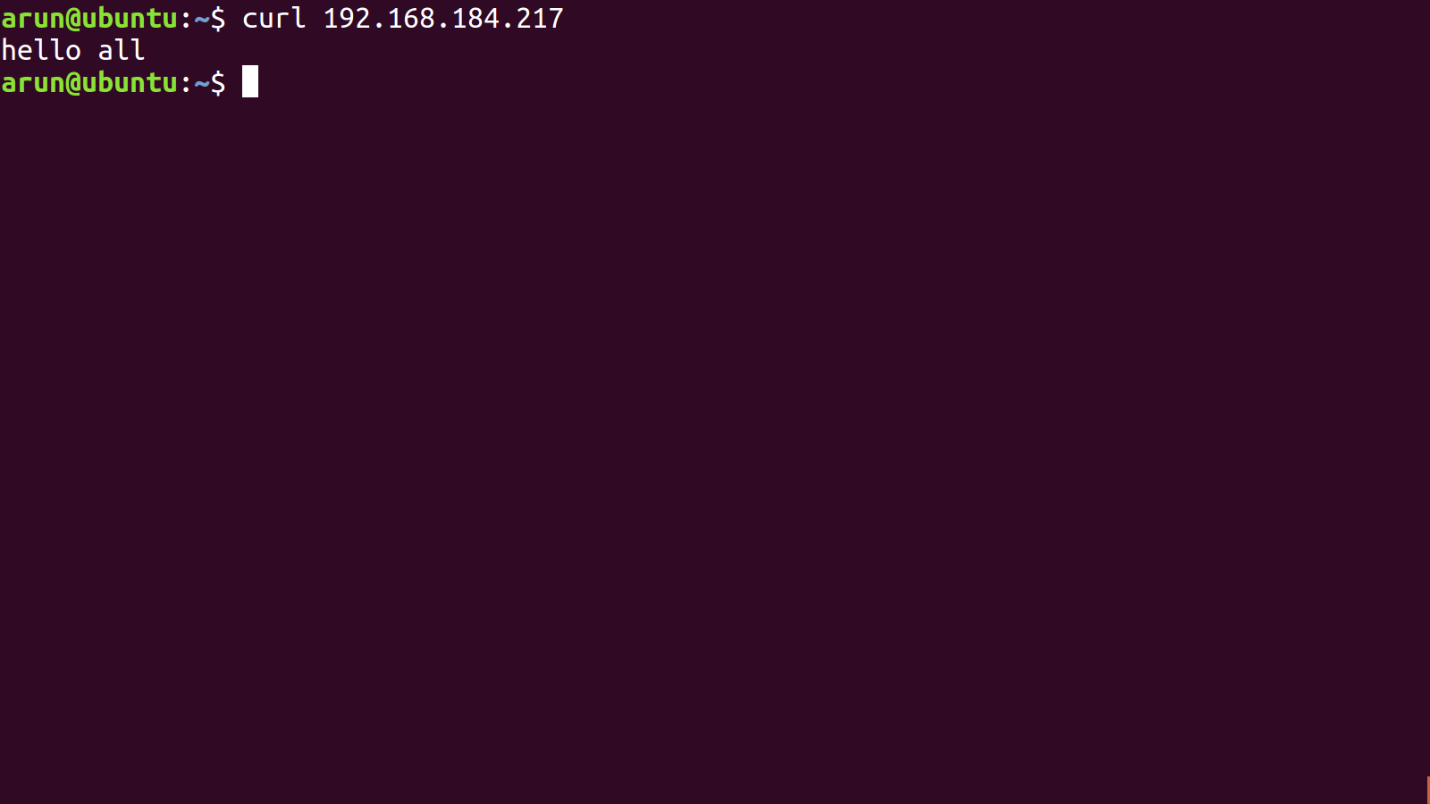

Slide 49
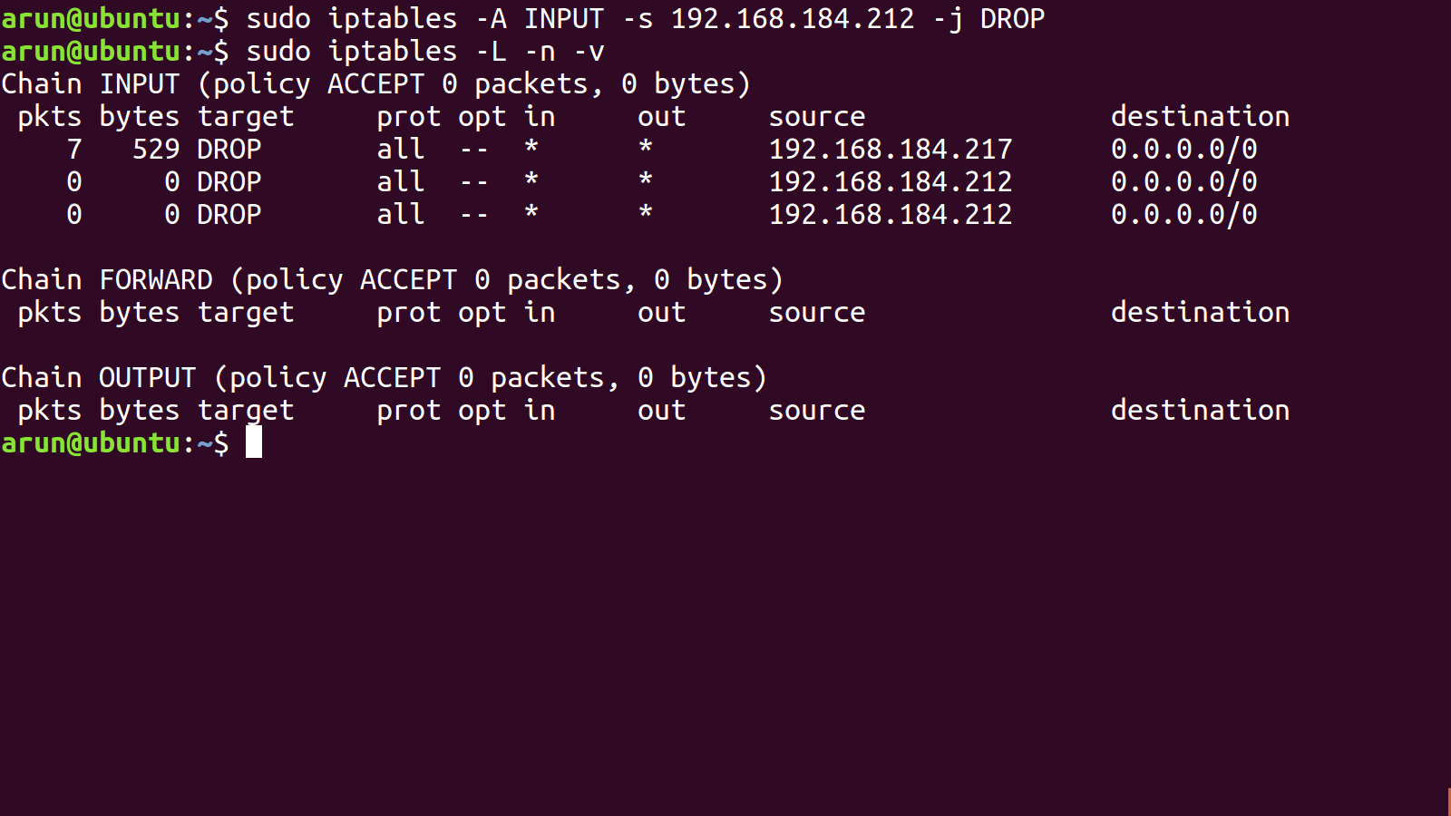

Slide 50
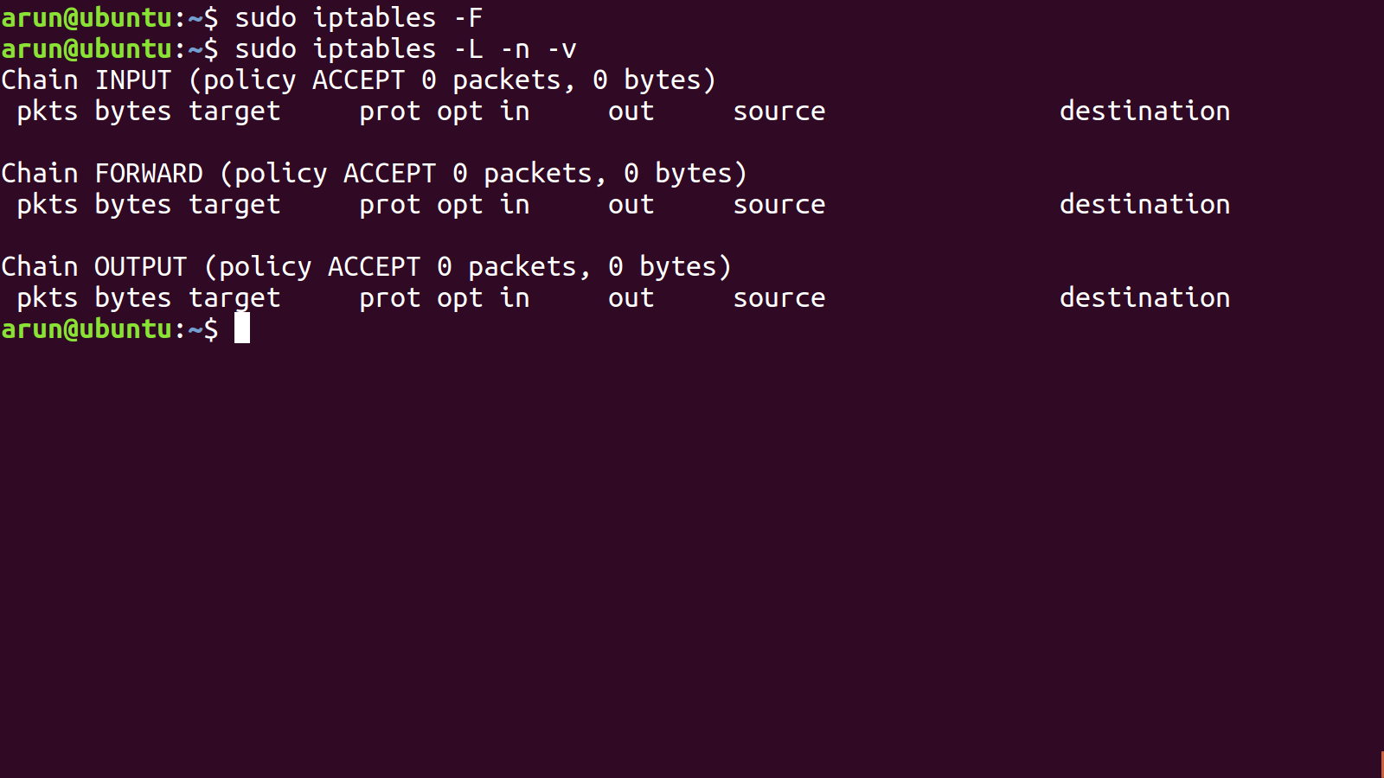

Slide 51
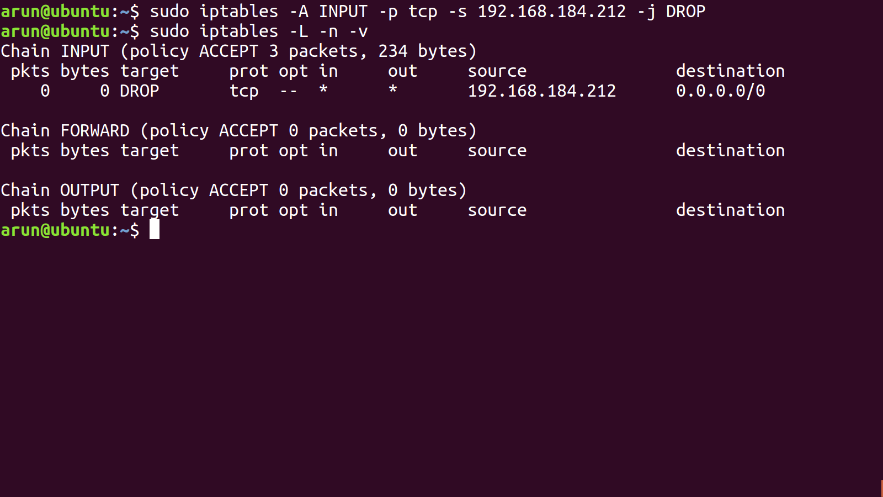

Slide 52
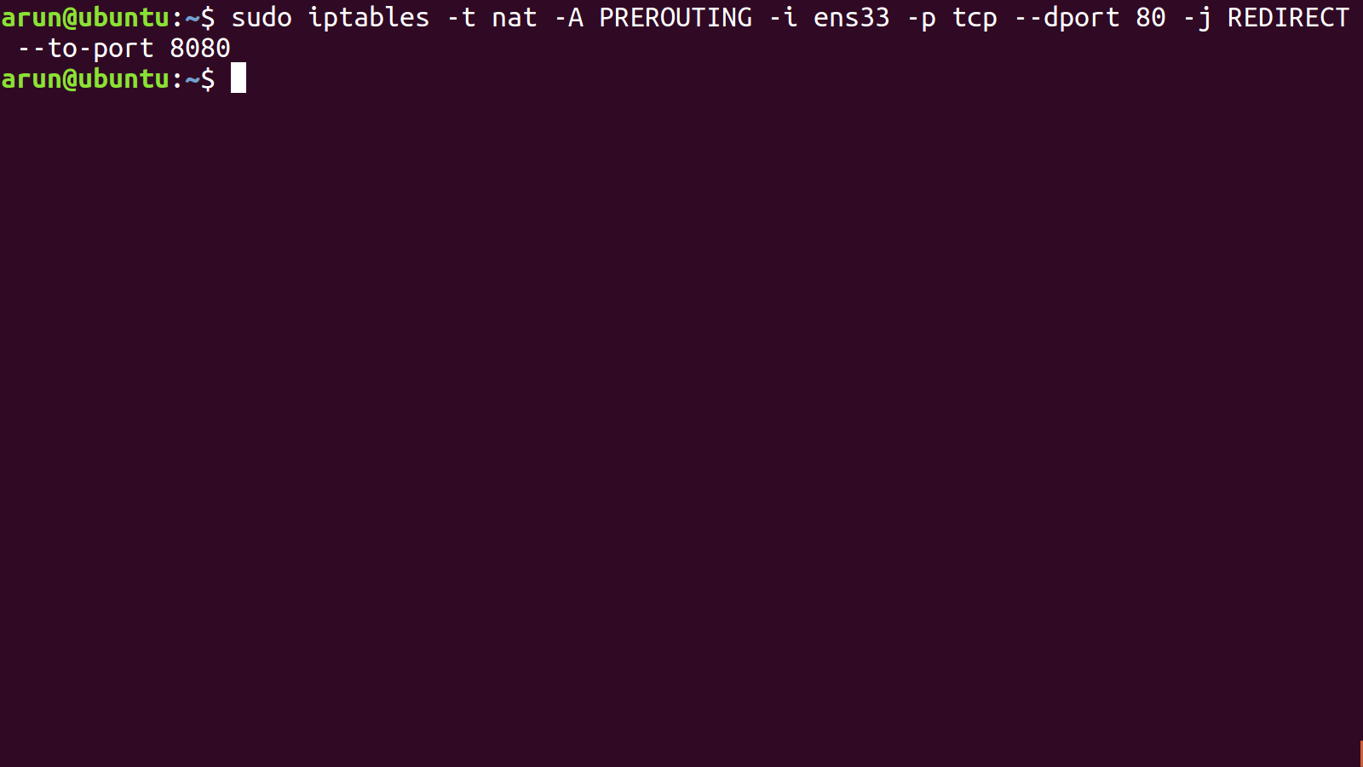

Slide 53
